Slide 1
Staffing
Important function of management concerned with the management of employees.
Selecting and Recruiting suitable personal
Utilize and promote the manpower
Training and Development Employee
Placement of manpower development
Staffing is the process of obtaining and maintaining capable and competent candidates to fill all the positions from the top level to the subordinate levels. It aims to select and appoint the right person at the right job at the right time in order to do a given job effectively and efficiently. It believes that one skilled staff is better than ten semi-skilled staff.
The staffing function includes recruiting, selecting, appointing, training, appraising, and maintaining employees in the organization. The main idea behind the staffing function is to hire skilled employees in the organization on the basis of the requirement to achieve defined goals.

Slide 2
Characteristics of Staffing
Staffing is the dynamic process
Staffing deals with present and future requirements
Important function of management and not a temporary exercise
Related to the human relationship and deals with present and future requirement
Concern with developing of employee and Responsibility for staffing
Staffing is a logical exercise which involves people
Staffing is a complex process

Slide 3
1.Important function of management and not a temporary exercise
Staffing is concerned with selection of manpower especially the managers. The function of staffing involves manning the organisation’s structure through careful selection, appraisal, development efforts etc. This function of management is not a new one rather; it is as old as the organisational itself is.
2. Concern with developing of employee and Responsibility for staffing.
Staffing is not the responsibility of personnel department alone. In fact, the responsibility for the efficient planning and execution of staffing function rests upon every manager at all levels. It will provides training, motivating and other kind skill development activities are held.
3. Related to the human relationship and deals with present and future requirement.
The main objective of staffing is to acquire the right employees and make the best use of them to achieve the business goals. Out of all the factors or production, employees are the only one in living form. Humans have feelings, emotions and self-respect. Since staffing is related with human element, humanitarian behaviour is expected towards them when they are made to work in the organization.
4.Staffing is a logical exercise which involves people.
The various logical steps to be followed in staffing are: manpower planning, recruitment, selection, induction, appraisal, training and maintenance of personnel. Staffing is a managerial function.

Slide 4
5. Staffing is the dynamic process.
Appropriate staff brings dynamism in all the activities of an organization. Staffing is not an activity which can be undertaken only temporary. It is a continuous activity so that required manpower is available throughout the year and at all times without any problem
6. Staffing deals with present and future requirements
Changes keep on taking place very frequently in the staff on account of retirements, resignations, deaths, terminations, etc. Staffing therefore not only deals with present but also with future. If own people are not developed, an organisation may have to hire people from outside.
7.Staffing is a complex process.
According to Wendell French “the broad personnel management function must be a joint effort of all managers within an organisation. The complex nature of staffing function stems from the fact that sometimes totally unrelated functions are assigned to staffing functions.” The complexity increases because an enterprise is a dynamic entity having a number of systems and sub-systems

Slide 5
5. Staffing is the dynamic process.
Appropriate staff brings dynamism in all the activities of an organization. Staffing is not an activity which can be undertaken only temporary. It is a continuous activity so that required manpower is available throughout the year and at all times without any problem
6. Staffing deals with present and future requirements
Changes keep on taking place very frequently in the staff on account of retirements, resignations, deaths, terminations, etc. Staffing therefore not only deals with present but also with future. If own people are not developed, an organisation may have to hire people from outside.
7.Staffing is a complex process.
According to Wendell French “the broad personnel management function must be a joint effort of all managers within an organisation. The complex nature of staffing function stems from the fact that sometimes totally unrelated functions are assigned to staffing functions.” The complexity increases because an enterprise is a dynamic entity having a number of systems and sub-systems

Slide 6
Improve Efficiency
Finding Competent Personnel
Importance of Staffing
Growth of the Organisation
Job Satisfaction
Optimum Utilisation of Human Resources

Slide 7
Staffing is an important function of management as it takes care of the manpower requirement of any organisation. In today’s environment with rapid changes taking place in technology, size of the organisations, etc. finding the right people for the job becomes critical. In such a scenario, proper staffing process plays an important role in the organisations. Following are the highlighted benefits of staffing in the current world scenario.
(i) Finding Competent Personnel: Staffing helps in finding and choosing the right personnel required for a job.
(ii) Improves Efficiency: By ensuring that right people are placed for right jobs, the overall efficiency and performance increases.
(iii) Growth of the Organisation: It ensures survival and growth of the organisation by appointing efficient and competent employees for various jobs.
(iv) Optimum Utilisation of Human Resources: Through proper manpower planning, staffing prevents over-utilisation or under-utilisation of manpower. In addition, it avoids interruption in working efficiency by suggesting, in advance if there is any unfilled job.
(v) Job Satisfaction: Compensation and fair rewards given to the employees provide them self-confidence and job-satisfaction. It encourages them to work diligently and give their best to the organisation.

Slide 8
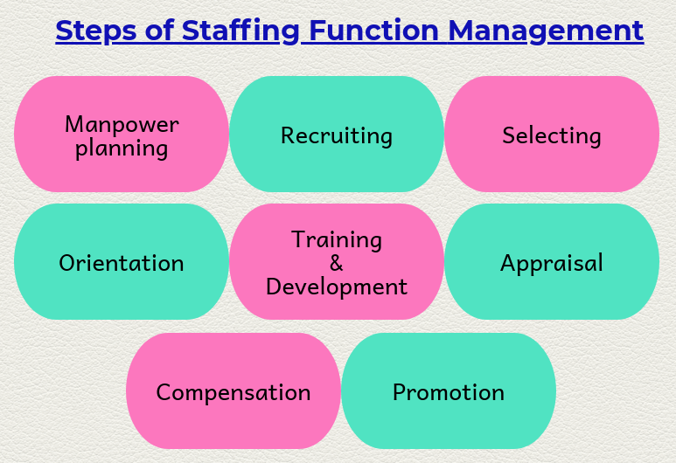
Function of Staffing

Slide 9
Manpower planning
It is the estimation of the workforce requirement and is the first step in the process of staffing as every step begins with the process of planning and identifying what is needed.
Recruiting
Once the positions are determined and the required qualification is outlined, the need to identify the people who fulfil the required criteria arises.
Selection
It is the process of screening & short listing the right person from a pool of eligible applicants. It is the distinct process sifting through the recruits to understand who can do that job better.
Orientation
It is the process by which new employees are introduced & made familiar to the workplace & company policies. Being a new employee, they must be made aware of terms and condition, rules, policies, objectives, benefits etc. of the organization.

Slide 10
Training & development
As the proverb says “Practice makes the Man Perfect”; similarly training & development plays an important role in policing & nurturing employees’ skills. Therefore, a complete training and development process must be done with the employee so that he/she can perform better for further employment.
Appraisal
Mere employment and training of employees is not the end of staffing function, it also includes the function of reward & appraisal with respect to the level of performance of each employee.
Compensation
Every employee needs to be compensated fairly for their hard work and efforts that he/she puts to your organization. All this depends on the criticality and nature of the job role of the employee.
Promotion
It is the elevation of the rank and the status of the employee which means a distinct change in the position of the employee. Promoting employees not only means a new position but also additional job roles, responsibilities & opportunities to shape their career in forward direction. It also includes giving them an opportunity to lead a team as their team leader or involve them with managerial functions, based on their experience, skills & expertise in that department.

